Slide 1
Micropelletisation Process for VenusRoses SC6
Case Study 6 (CS6) – VenusRoses Lab Solutions

Slide 2
Introduction
Overview of the micropelletisation process
Focus on nano-TiO₂-based micropellets for cosmetic applications
Aligning process with KPIs and Design Constraints
Preparation for DoE and Life Cycle Assessment (LCA)

Slide 3
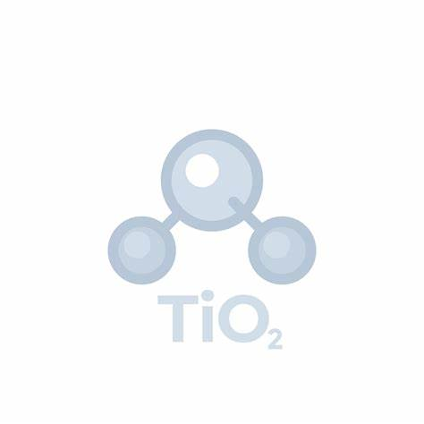
Micropelletisation Process Overview
Incorporation of nano-TiO₂-based materials with Active Ingredients
Utilized in cosmetic formulations for UV protection & anti-aging
Ensuring stability and uniform distribution

Slide 4
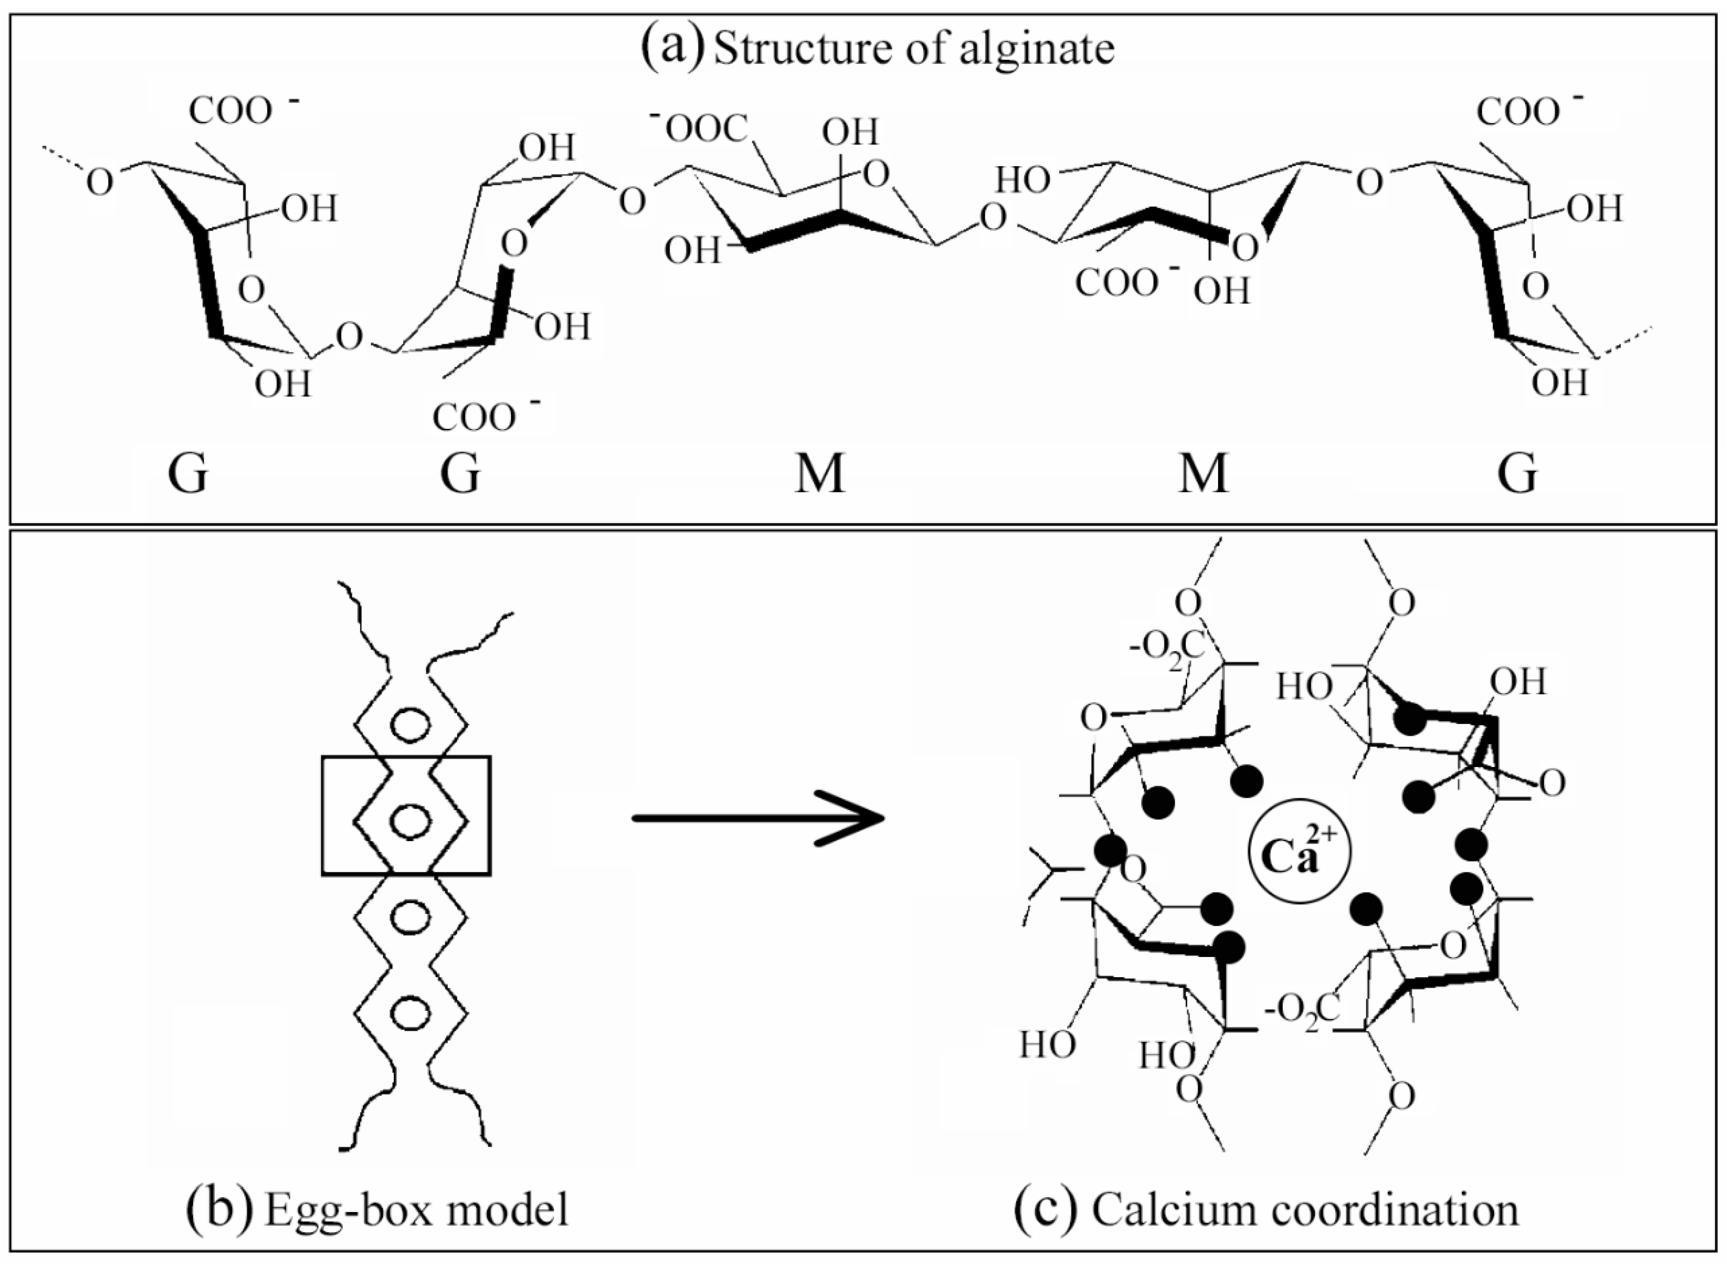
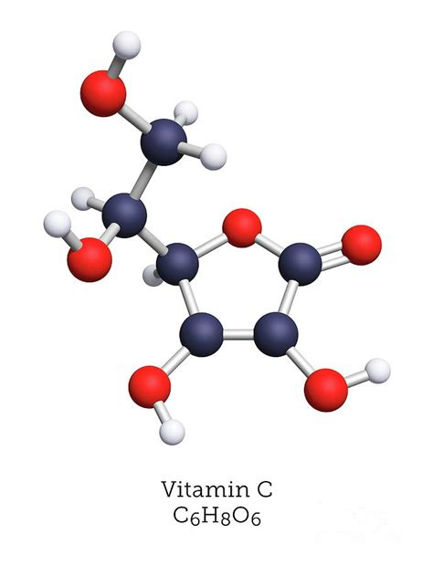
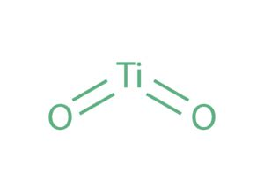
Process Inputs
Base Materials: Nano-TiO₂, Bio-SiO₂ (from rice husk), SiO₂@TiO₂ nanoparticles
Active Ingredients (e.g., Vitamin C)
Carriers: Alginate, Cellulose
Alginate egg-cell model after CaCl₂ crosslinking

Slide 5
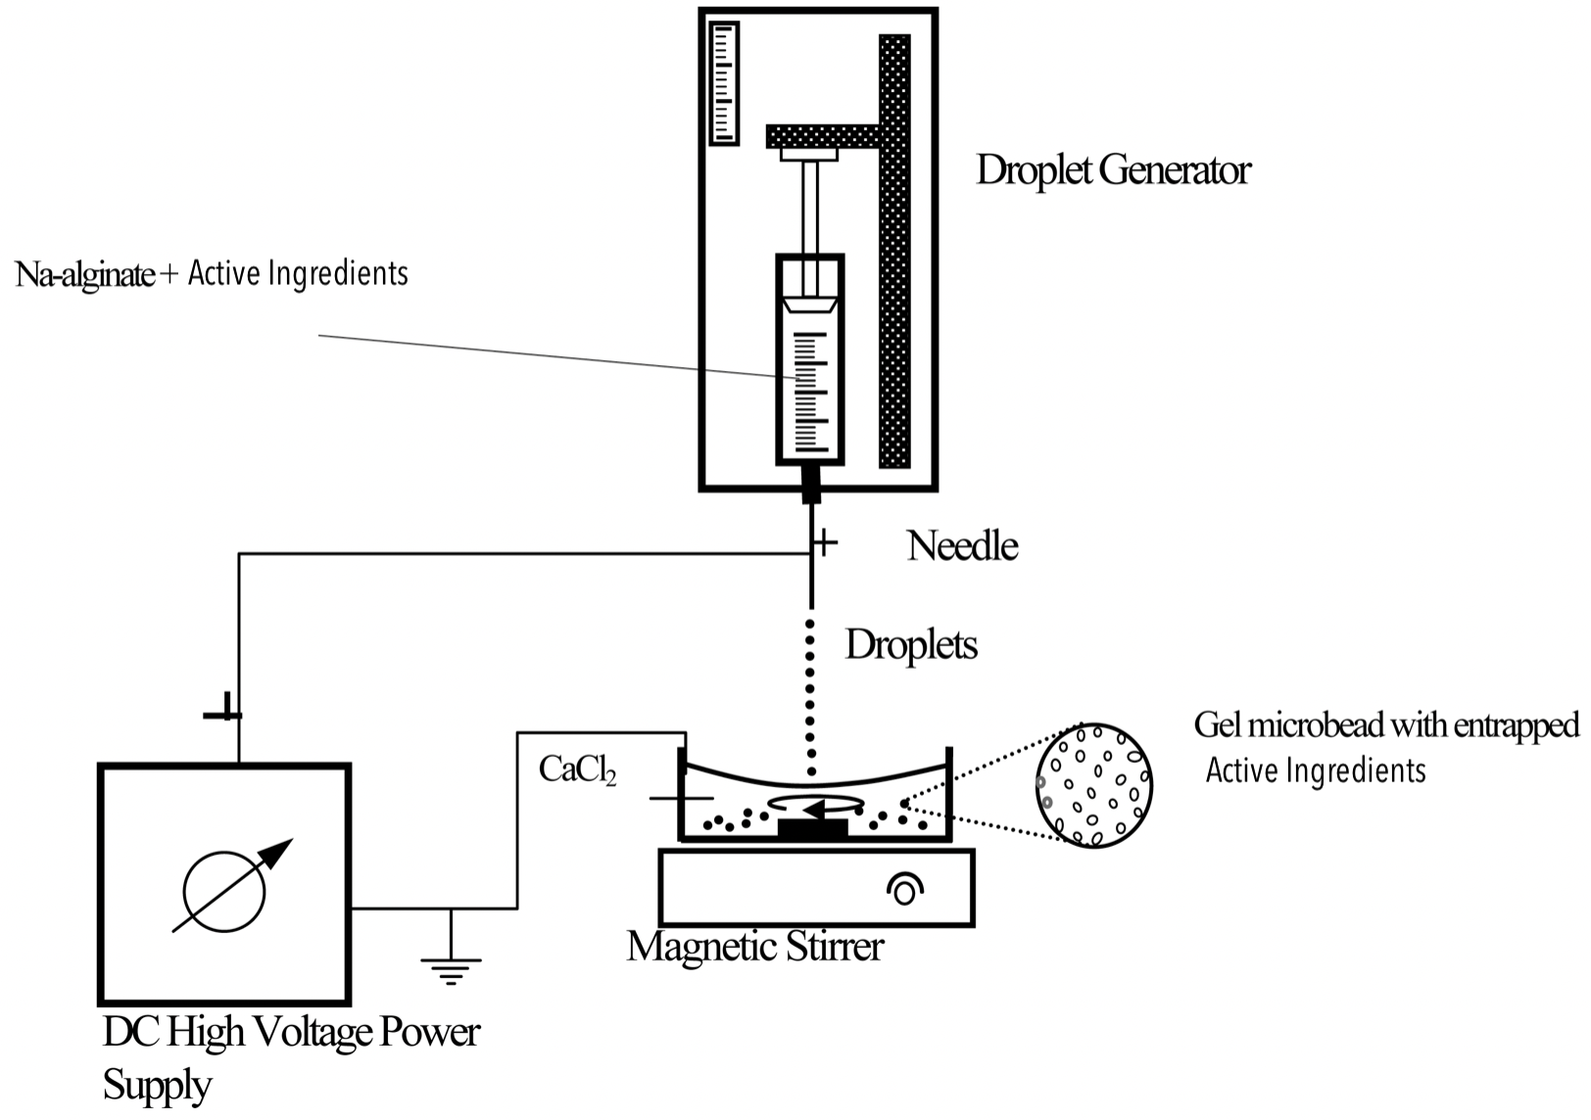
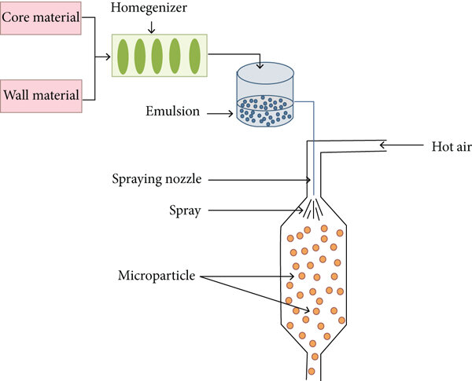
Process Steps
Electrostatic Extrusion
Incorporation of Active Ingredient (Vitamin C) and SiO₂@TiO₂ with the biopolymer.
Homogenization and stabilization
Micropelletisation using Electrostatic Extrusion, spray or vacuum drying
Integration into cosmetic formulations
Spray Drying

Slide 6
Key Performance Indicators (KPIs)
Micropellet formulation & stability
Incorporation of UV-blocking and Vitamin C with the biopolymer
Nano- Micro-particle to active ingredients ratio
Emulsion and particle stability
Shelf-life testing
Active ingredient release in various conditions

Slide 7
Key Design Factors (KDFs)
Size and uniformity of nano- micro-particles
Compatibility of active ingredients with SiO₂@TiO₂
Control of temperature and humidity during the process
Techniques for micropelletisation: Electrostatic Extrusion and Spray or Vacuum Drying

Slide 8
Discussion Points for CS6 Meeting
Identifying threshold values for cost & functionality
Conducting Design of Experiments (DoE) & Life Cycle Assessment (LCA)
Addressing data gaps & evaluating safety risks

Slide 9
Technical & Economic Data
Technical: Nano-TiO₂ properties, synthesis, micropelletisation methods, active ingredient composition, stability metrics
Economic: Raw material costs, energy consumption, waste generation, environmental impact

Slide 10
Next Steps
Analytical description of micropelletisation methods
Define lab and/or pilot scale material quantities
Align on functionality & cost thresholds
Finalize DoE setup & LCA contribution
Fill data gaps and assess safety profile

