Slide 1




Meeting
14/05/2025
MULTIDIMENSIONAL INTEGRATED QUANTITATIVE APPROACH TO ASSESS SAFETY AND SUSTAINABILITY OF NANOMATERIALS IN REAL CASE LIFE CYCLE SCENARIOS USING NANOSPECIFIC IMPACT CATEGORIES
STEFANO CERVELLERA
This project has received funding from the European Union’s Horizon Europe research and innovation programme under GA No 101138414

Slide 2

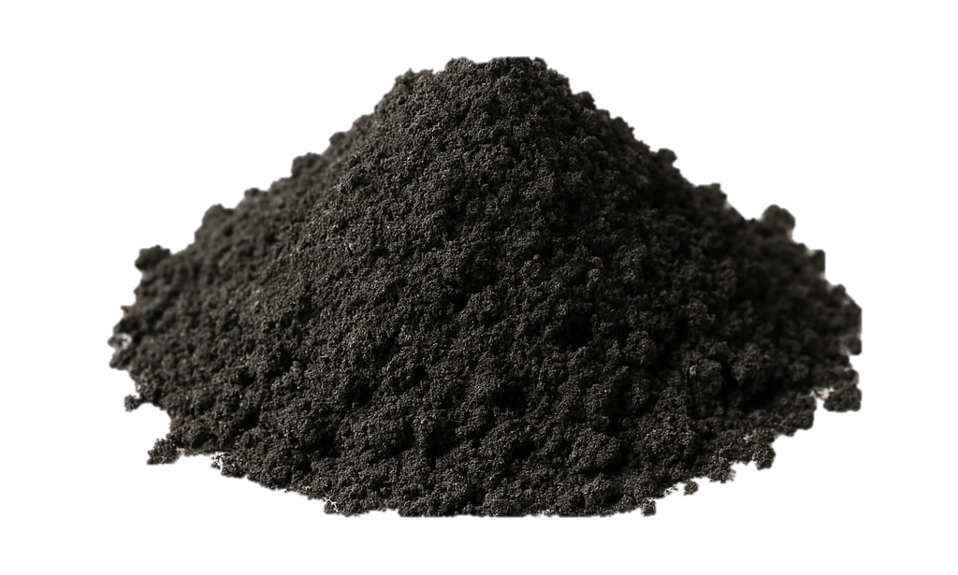
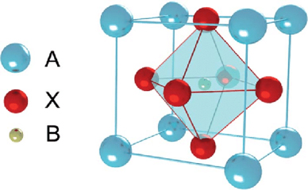
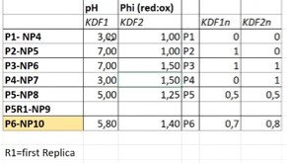


Perovskites
AB$X_{3}$
Sr
O
Fe / Ce
Inclusion of
Bio-Silica
KDF 1 - pH
1
NP5
NP6
0
NP4
NP7
0
1
KDF 2 – Red:Ox
INTEGRANO project – GA No: 101138414

Slide 3
Characterization
Graphs report mean and standard deviation from three independent experiments
INTEGRANO project – GA No: 101138414

Slide 4
Cell Viability
Graphs report mean and standard deviation from three independent experiments
INTEGRANO project – GA No: 101138414

Slide 5
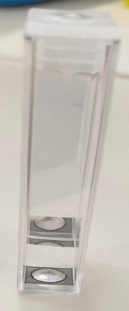
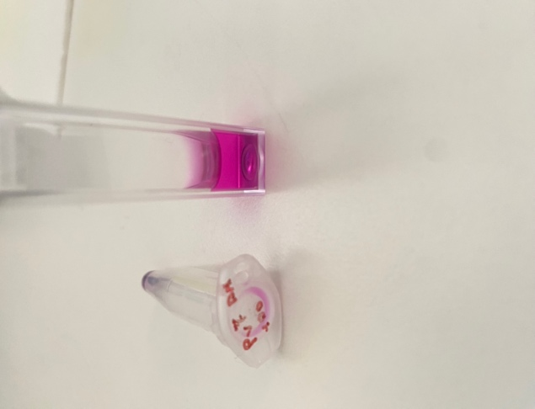
Cell Viability – why such differences
PARAMETER | NP4 (mean + sd) | NP5 (mean + sd)
DLS in MEDIUM t=0 100 ug/ml | 1565,22 ± 445,98 | 613,39 ± 122,74
DLS in MEDIUM t=24 100 ug/ml | 181,58 ± 13,62 | 196,34 ± 10,84
DLS in MEDIUM t=0 10 ug/ml | 1013,58 ± 434,84 | 593,48 ± 185,53
DLS in MEDIUM t=24 10 ug/ml | 192,55 ± 9,95 | 191,73 ± 9,99
Z-pot t=0 MQ | -23,26 ± 3,04 | -23,67 ± 2,47
KDF 1 – pH
Cell viability
1
NP5
=
NP6
=
=
0
NP4
NP7
0
1
KDF 2 – Red:Ox
INTEGRANO project – GA No: 101138414

Slide 6
Cell Viability
Graphs report mean and standard deviation from three independent experiments
INTEGRANO project – GA No: 101138414

Slide 7
Cell Viability – why such differences
PARAMETER | NP6 (mean + sd) | NP7 (mean + sd)
DLS in MEDIUM t=0 100 ug/ml | 979,12 ± 363,84 | 975,38 ± 204,88
DLS in MEDIUM t=24 100 ug/ml | 177,59 ± 6,32 | 188,5 ± 5,85
DLS in MEDIUM t=0 10 ug/ml | 1396,33 ± 213,29 | 1830,36 ± 178,85
DLS in MEDIUM t=24 10 ug/ml | 185,03 ± 3,21 | 186,71 ± 6,82
Z-pot t0 MQ | -17,42 ± 4,56 | -20,55 ± 4,28
KDF 1 – pH
Cell viability
1
NP5
=
NP6
=
=
0
NP4
NP7
0
1
KDF 2 – Red:Ox
INTEGRANO project – GA No: 101138414

Slide 8
INFLAMMATION
Graphs report mean and standard deviation from three independent experiments
INTEGRANO project – GA No: 101138414

Slide 9
INFLAMMATION
Graphs report mean and standard deviation from three independent experiments
INTEGRANO project – GA No: 101138414

Slide 10
In the coming months
Endpoints
Assays
H₂DCFDA
DNA damage
yH2AX Ab
Oxidative stress
INTEGRANO project – GA No: 101138414

